Slide 1
Severity Classification Prediction on Gun Violence Data
Team: Savage Data Warriors
Sangeeta Kumawat, Priyanka Vyas, Jenifer Werthman

Slide 2
Motivation & Problem Statement
Motivation
Goal: Identify High, Moderate and Low Severity class using Gun Violence incidents.
Data
Gun Violence Data(2013-2018)
Size - 239,677 Rows; 29 original columns
Analysis
Gun Violence by State and City/County
Gun Violence by Age Group / Sex / participants
Gun Violence Victims - killed and injured

Slide 3
Literature Review
Research
5 papers surveyed
Paper 1: Predicting Type of Crime
Data: RMS Crime Incidents from city of Michigan (2020), using NN
Results: 16%/27% vs 14% manually guessing
Paper 2: Estimating real time burson of weekly and annual firearm homicides
Data: Multiple sources combined together such as Emergency hotlines and Medical services, using SARIMA
Results: 95-99% accuracy
Paper 3: Test correlation between gun violence and gun purchases
Data: National Instant Criminal Background Check System (1998-2016), using ARIMA modeling
Results: 26 shootings (21.0%) were associated with increases in gun purchases
Paper 4: Predicting terrorist activities using CNN and LSTM
Data: Global Terriosm Database
Results: CNN-LSTM yielded 99% accuracy
Paper 5: Real World Violence Detection in Surveillance Cameras
Data: UCF crime dataset using CNN(Resnet50) for feature extraction and (ConvLSTM) for detecting abnormal events in time series dataset.
Results: 81.71 % accuracy in AUC.

Slide 4
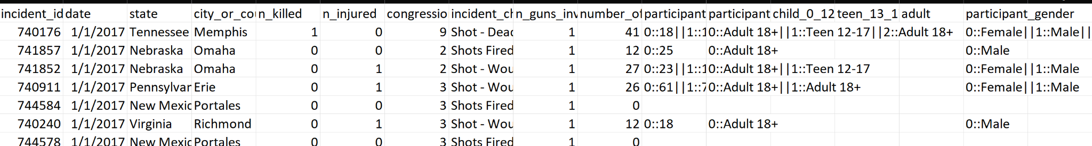
Data Exploration
Implementation
Data Exploration and Feature Selection: Normalization/regularization
Scrubbed data parsing age groups, gender, and participants
Determine relationships and correlations between features
Determined relevant labels (Severity -High/Medium/Low)
Create relevant clusters
Select relevant features
Labels: Severity of events
Features: State and Victims

Slide 5
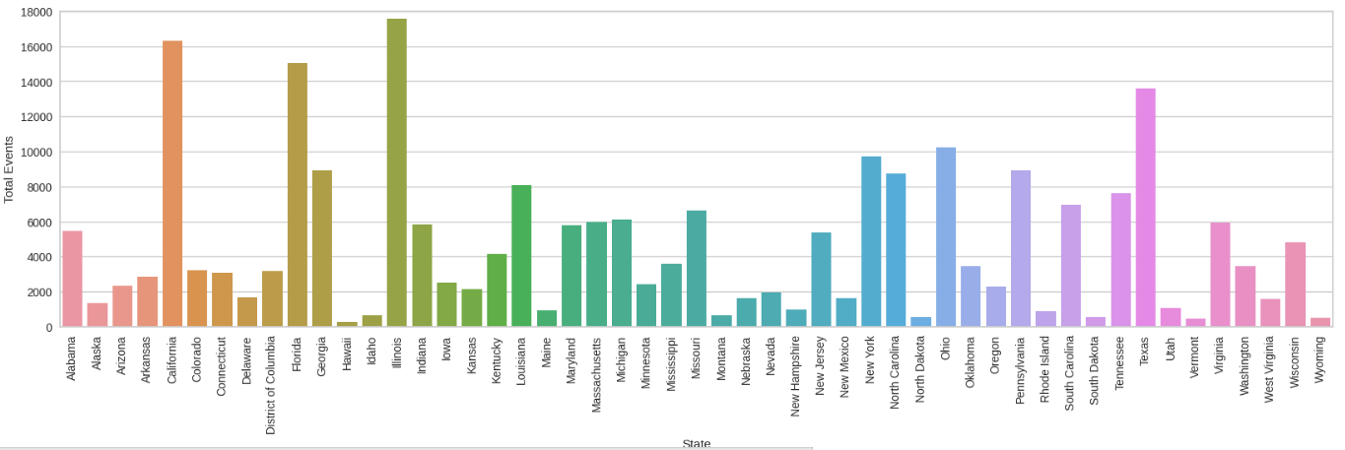
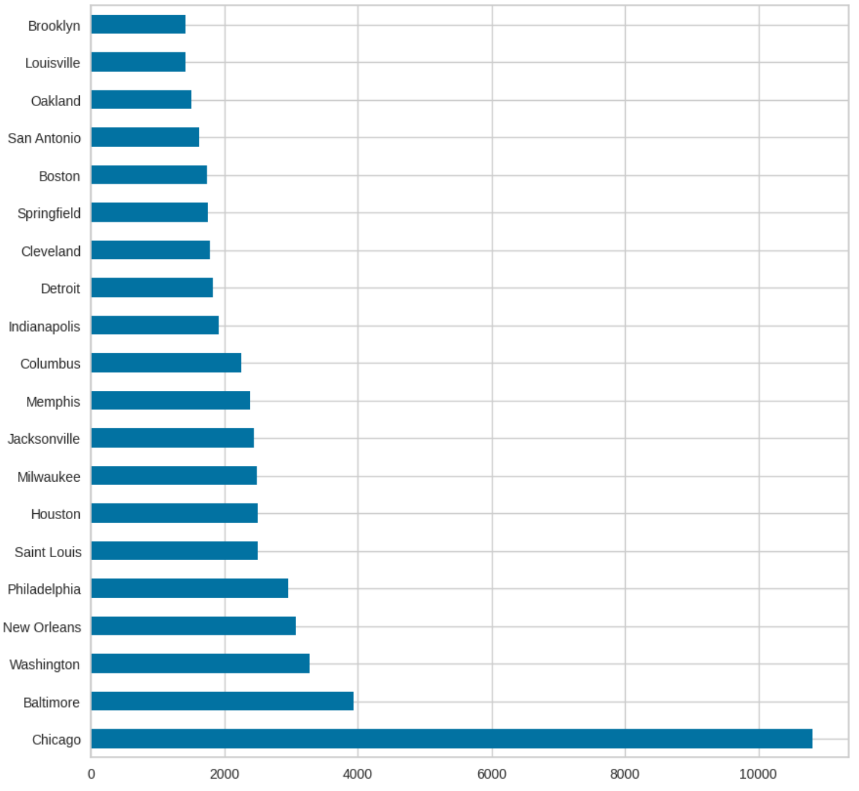
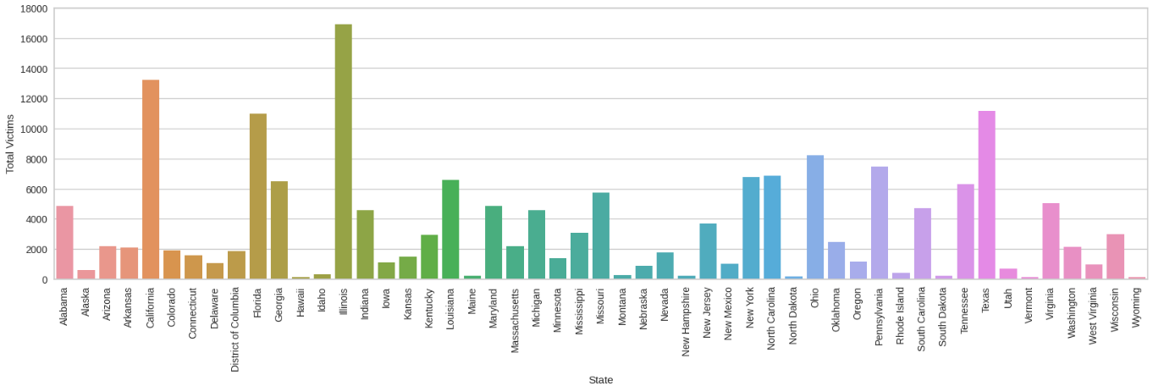
Data Visualization
Implementation
Events by State
Top Cities with Highest Event Count
Victims by State

Slide 6
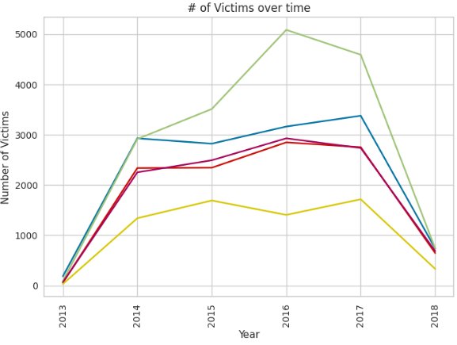
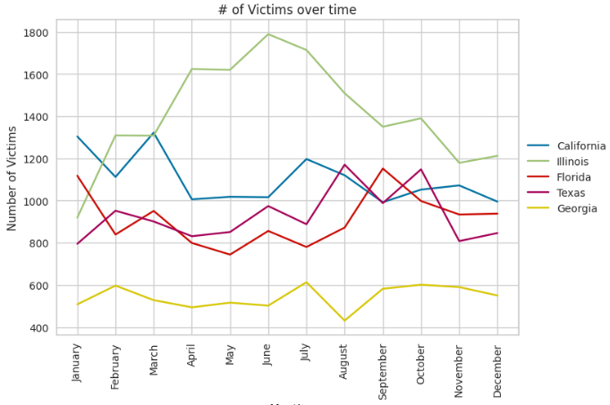
Data Visualization
Implementation
Top 10 States with Highest Severity events

Slide 7
Methodology: Classification Problem
Implementation
01
Load the dataset
Data Preprocessing
Create Binary Labels
Exploratory Data Analysis
02
Train Binary Classifiers
Combine Probabilities
Data Modeling
03
Compute ROC curve and AUC score
Compute Accuracy score
Plot ROC curve and Confusion Matrix
Model Evaluation and Visualization

Slide 8
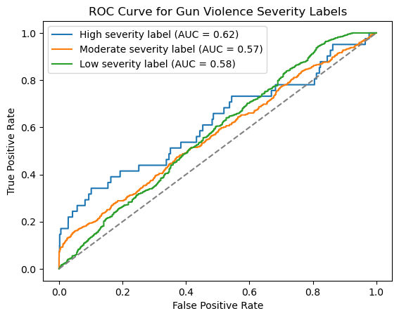
Experimental Evaluation
Implementation
Train 3 separate binary classifiers for each label.
Uses LabelEncoder to encode Categorical features
Class labels are based on number of victims.
High Severity: n_victim ⩾ 7
Moderate Severity: 4 ⩽ n_victim﹤7
Low Severity: n_victim﹤4
Perform Logistic Regression and Evaluate Model.

Slide 9
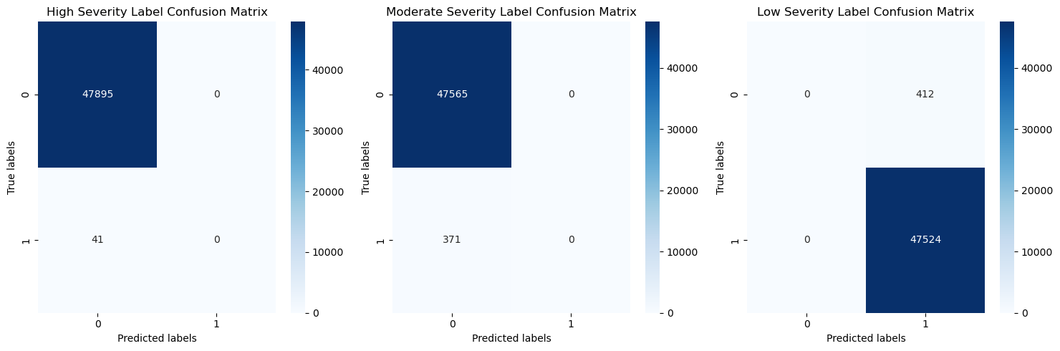
Experimental Evaluation
Accuracy score for high severity label: 0.9991
Accuracy score for moderate severity label: 0.992
Accuracy score for low severity label: 0.991
Implementation

Slide 10
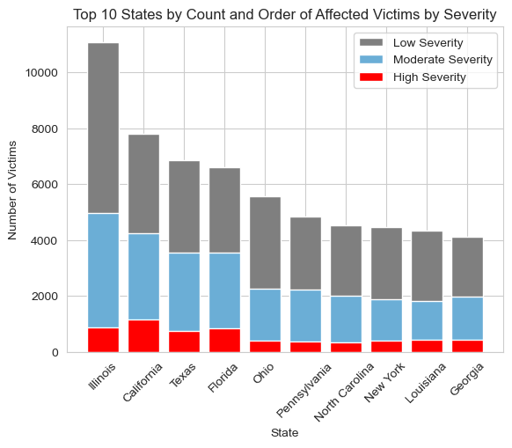
Implementation Difficulties
Issues & Limitations
Feature Selection i.e. Choosing the best features and labels.
Handling Missing values.
Class Imbalance.
Getting recent data after 2018.

Slide 11
Conclusion
Model performs well in terms of Accuracy.
Model performance is better than random guessing.
Confusion matrix predicts the positive and negative instances for severity labels.
Future Work
LSTM / RNN Prediction
Gun/Weapon Analysis
Month Analysis and Risk
Questions?
Thank you!

Slide 12
References:
Paper 1: Walczak, Steven. (2021). Predicting Crime and Other Uses of Neural Networks in Police Decision Making. Frontiers in Psychology. 12. 587943. 10.3389/fpsyg.2021.587943.
Paper 2: Swedo EA, Alic A, Law RK, et al. Development of a Machine Learning Model to Estimate US Firearm Homicides in Near Real Time. JAMA Netw Open. 2023;6(3):e233413. doi:10.1001/jamanetworkopen.2023.3413
Paper 3: Real World Violence Detection in Surveillance Cameras. Liu, Gina & Wiebe, Douglas. (2019). A Time-Series Analysis of Firearm Purchasing After Mass Shooting Events in the United States. JAMA Network Open. 2. e191736. 10.1001/jamanetworkopen.2019.1736.
Paper 4: Firas Saidi, Zouheir Trabelsi,A hybrid deep learning-based framework for future terrorist activities modeling and prediction,Egyptian Informatics Journal,Volume 23, Issue 3,2022,Pages 437-446,ISSN 1110-8665, https://doi.org/10.1016/j.eij.2022.04.001.
Paper 5: CNN-RNN Combined Structure for Real-World Violence Detection in Surveillance Cameras. Soheil Vosta, Kim-Choong Yow https://doi.org/10.3390/app12031021
Data: https://www.kaggle.com/datasets/jameslko/gun-violence-data from http://www.gunviolencearchive.org/

